Slide 1
HR Absenteeism Analytics
Python Notebook
https://colab.research.google.com/drive/1Z98EhmWZMQ5rFLW-k7oLJCnNENSCGtha?usp=sharing
Visualization done using Matplotlib

Slide 2
Introduction
The HR department has a diverse range of responsibilities beyond hiring, including finding, selecting, onboarding, and monitoring talent. Analytics can aid in smooth workforce monitoring, particularly in identifying pockets of absence that may require interventions. This dataset focuses on employee absence at work, with 740 rows and 21 columns of data. Factors such as age and length of service may be associated with absence, but further analysis is needed. The dataset includes information on employee demographics, workload, distance from work, education, and absenteeism duration. Proper data structuring and combining records for individual employees pose challenges. The dataset allows for longitudinal research, enabling the study of patterns over time.

Slide 3
Objective
To create a report or use analytics concept to provide a smooth monitoring of workforce for the HR department.
Potential analysis could be to see if there is association between BMI and absence, as well as season, workload, distance from work and the other factors in the data
Benefits:
Detection of reason for absenteeism.
Gives better insight of customers base.

Slide 4
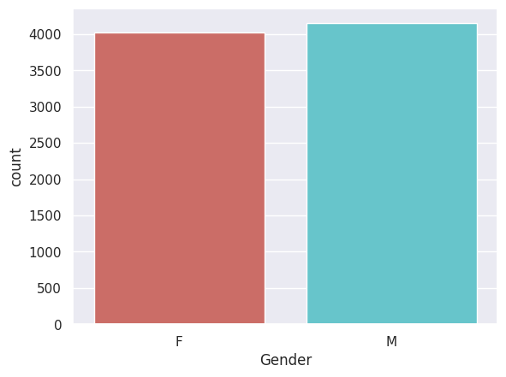
Plots
1- The workforce comprises a nearly equal number of male and female employees.
2- The majority of employees are stationed at stores, while a smaller proportion work at the head office.

Slide 5
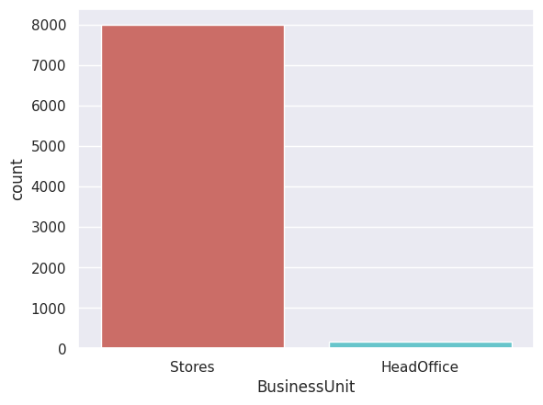
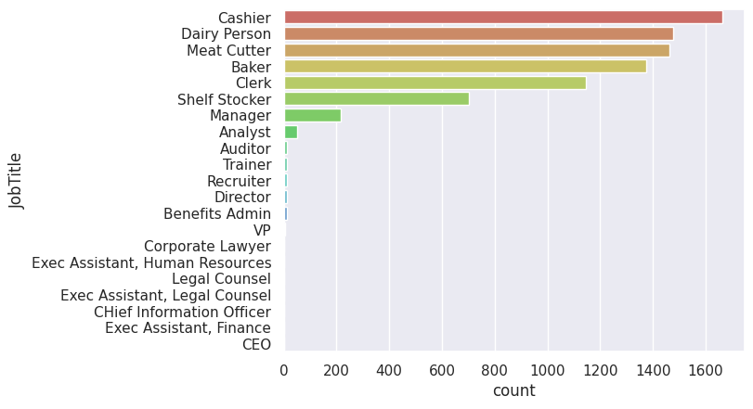
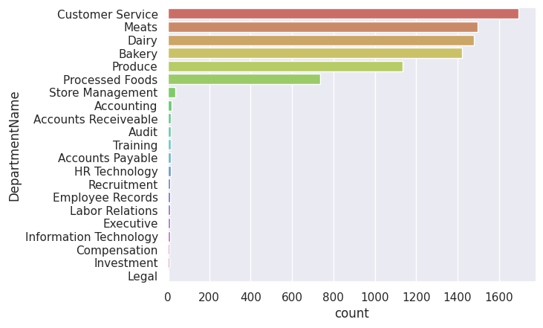
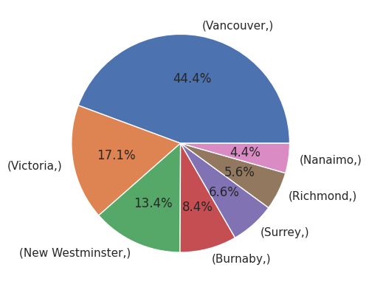

Slide 6
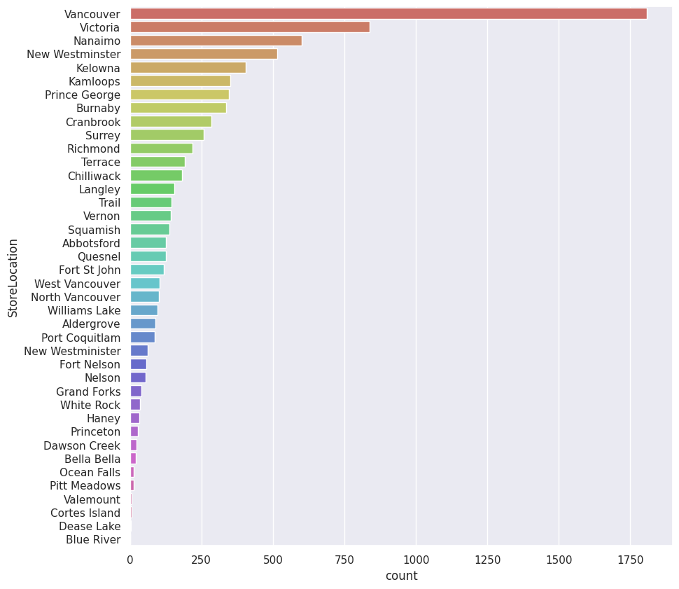
The majority of individuals are employed in customer service as cashiers, while in the bakery sector, the prominent roles are meat cutters and bakers.
Vancouver has the highest concentration of stores, followed by Victoria, Nanaimo, and finally New Westminster, in terms of their distribution across the region.

Slide 7
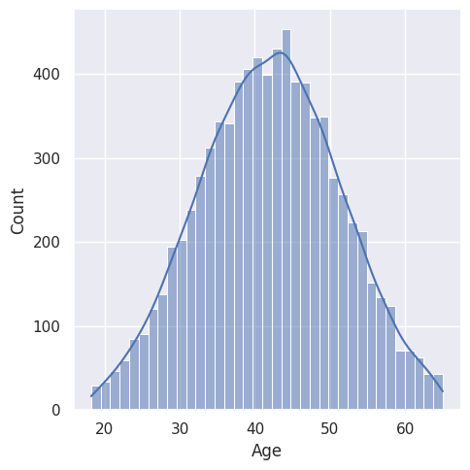
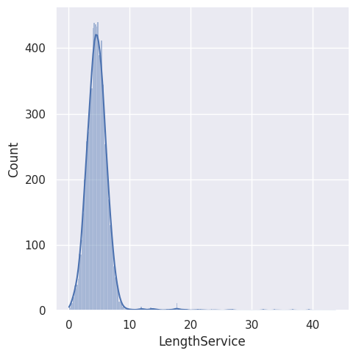
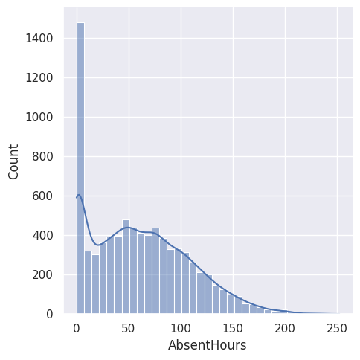

Slide 8
The distribution of age follows a normal distribution pattern, indicating that it is evenly spread across a range of values.
The length of service exhibits a slight right skew, implying that there are more employees with shorter tenures compared to those with longer tenures.
Absenteeism hours are characterized by a log-normal distribution, suggesting that there are a limited number of employees who are absent for extended periods, while the majority of employees have shorter periods of absence.

Slide 9
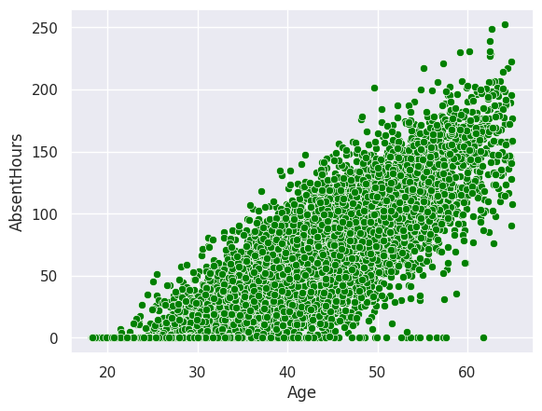
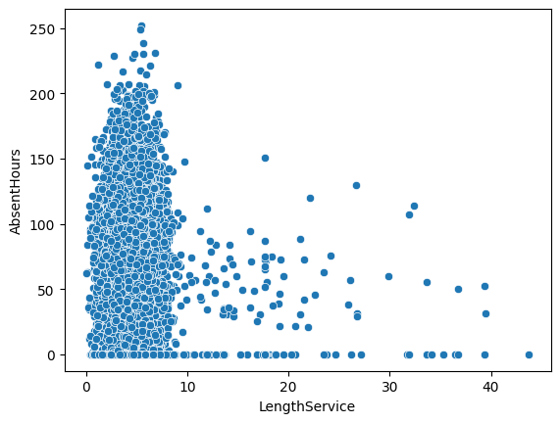

Slide 10
A noticeable trend emerges as age increases, indicating a corresponding increase in the number of absent hours among employees.
On the other hand, there is no strong correlation between length of service and absent hours. However, it is interesting to note that employees with shorter length of service tend to have a higher number of absent hours, displaying a right-skewed distribution.

Slide 11
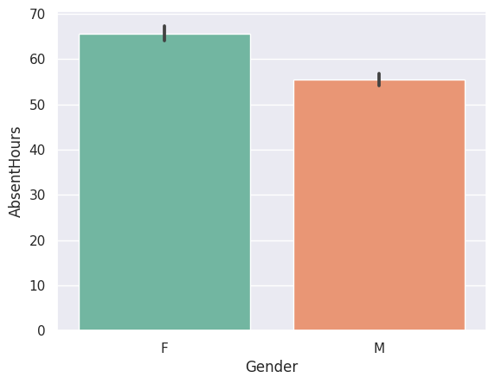
Females demonstrate higher levels of absenteeism than males, with a tendency for more absent hours.

Slide 12
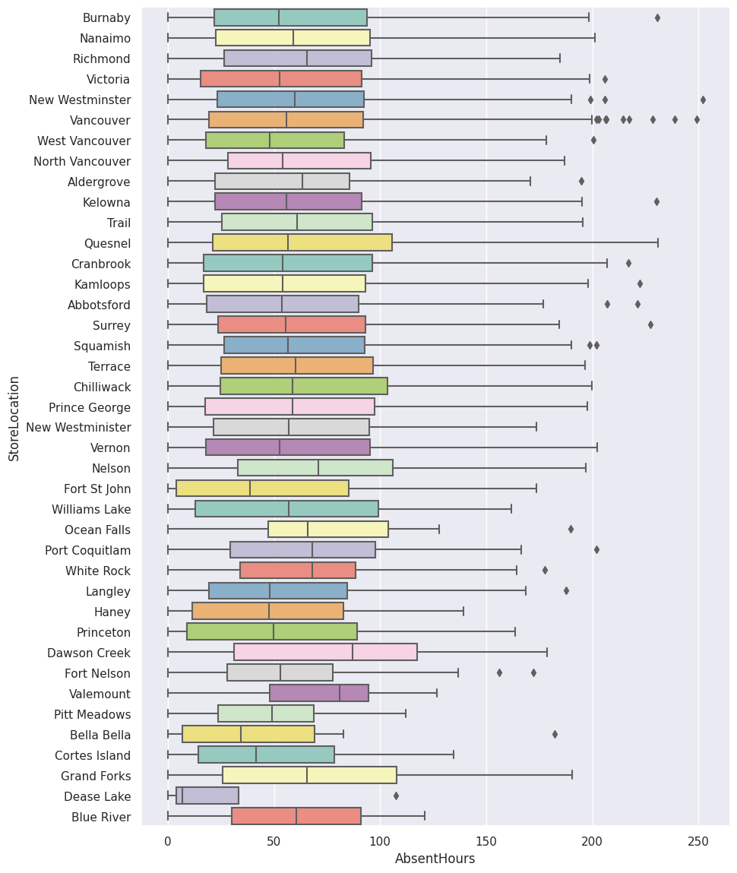
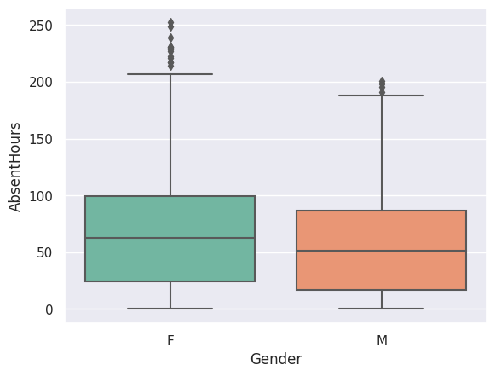
Females have more outliers than men which means some Females are Absent for longer period of time than men.

Slide 13
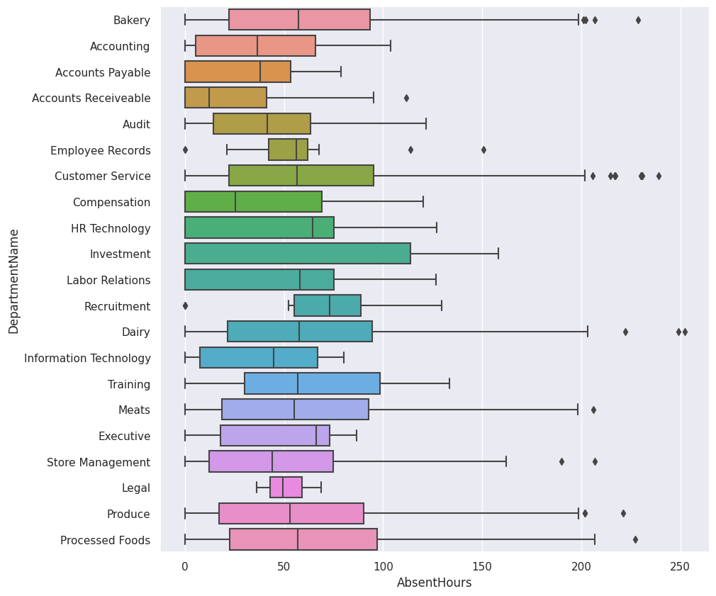
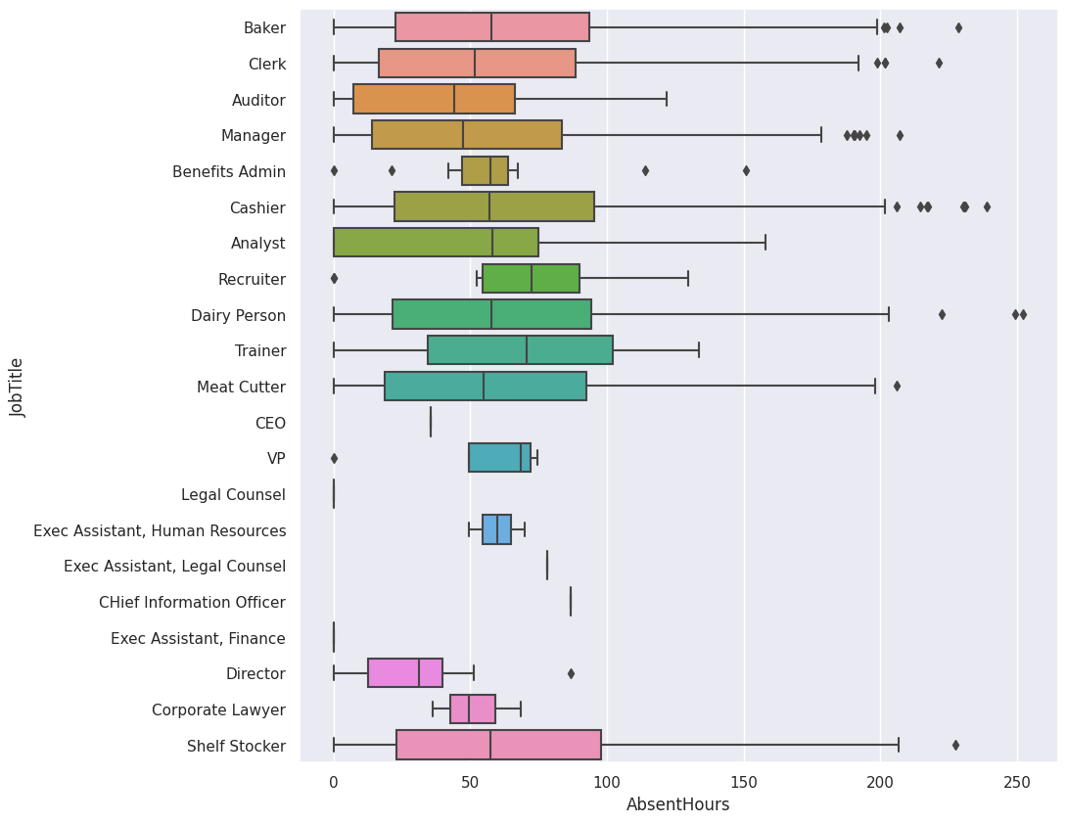
Vancouver stands out as the location with the highest number of outliers, indicating a significant presence of employees with a high number of absent hours

Slide 14
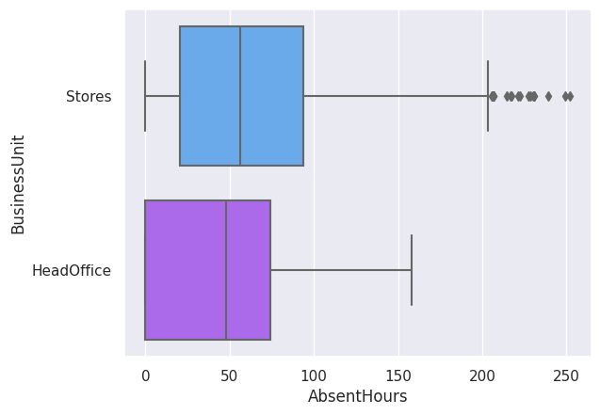
Cashiers show higher absenteeism compared to other job titles.
The dairy person not only has higher absenteeism but also holds the record for the highest number of absent hours, reaching 249 and 252 hours.

Slide 15
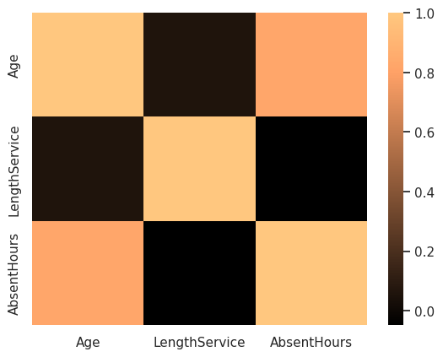
Age and absent hours are positively correlated, indicating that absenteeism tends to increase with age. Length of service does not show a significant correlation with absent hours.
Females have higher levels of absenteeism compared to males, with females also being absent for longer durations.
Vancouver has the highest rate of absenteeism among the different store locations.
conclusions

Slide 16
Thank You

